Slide 1
Lecture 1: Introduction

Slide 2
Outline
Why should you take this class and why not?
Who are we?
Course structure and activities?
Class organization (Workload, Logistics, Grades).
Projects

Slide 3
Outline
Why should you take this class and why not?
Who are we?
Course structure and activities?
Class organization (Workload, Logistics, Grades).
Projects

Slide 4
Outline
Why should you take this class and why not?
Who are we?
Course structure and activities?
Class organization (Workload, Logistics, Grades).
Projects

Slide 5
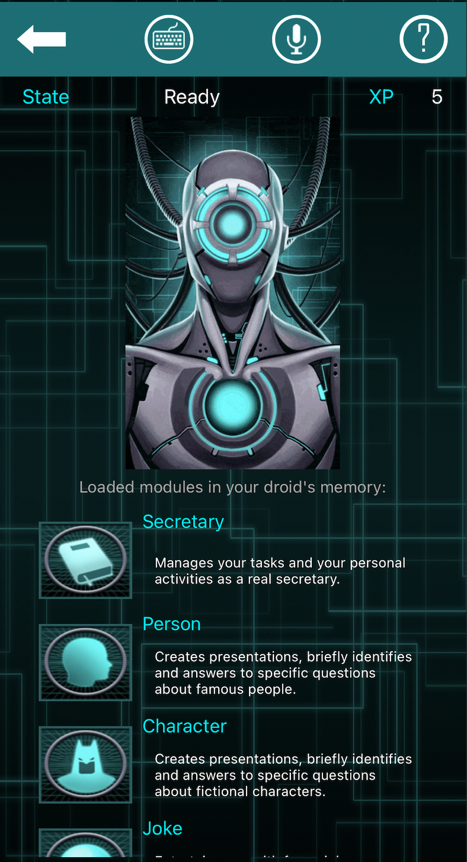

Why you should take this class
So you can build awesome apps like this:
https://runwayml.com/
https://www.databot-app.com/
Notes:
runwayml: Magical AI tools, realtime collaboration, precision editing, and more. Your next-generation video creation suite.
DataBot: is the protocol droid designed
to serve you. It answers with its voice to your requests
upon topic you are interested in.

Slide 6
Why you should take this class
Because you want to learn how to:
Put your models in production
Build an application using your models
Take advantage of available models
Integrate and orchestrate applications
Deploy increasing amount of data

Slide 7
Reasons This Course May Not Be For You
1. Lack of Commitment: This course demands full engagement with materials and projects.
2. Expectation of a Traditional Lecture Format: This is a project-based course, with a focus on hands-on learning.
3. Limited Background in Prerequisites: If you are unfamiliar with key concepts from CS109A/B such as:
Basic Machine Learning
CNNs, RNNs, Autoencoders, GANs, etc.
Basic shell commands.

Slide 8
Why you shouldn’t take this class
4. Unwillingness to Receive and Apply Feedback: We provide detailed feedback on your projects, expecting you to implement changes in subsequent milestones.
5. Seeking a "Easy A": While project-based courses may seem easier, we hold rigorous evaluation standards.

Slide 9
Motivation
Mckinsey Global Survey findings on Adoption of AI shows nearly 25% year over year increase in the use of AI. 50% of companies spend between 8 and 90 days deploying a single AI model, with 18% taking longer than 90 days. A report by IDC that surveyed 2,473 organizations and their experience with ML found that a significant portion of attempted deployments fail, quoting lack of expertise, as one of the key factors.^{[1]}
[1] https://arxiv.org/pdf/2011.09926.pdf
Notes:
International Data Corporation (IDC)
https://venturebeat.com/ai/idc-for-1-in-4-companies-half-of-all-ai-projects-fail/: Despite enterprises’ best efforts, painless AI deployments appear destined to remain elusive for all but the most dogged adopters. A recent study conducted by analysts at International Data Corporation (IDC) found that of the organizations already using AI, only 25% have developed an “enterprise-wide” AI strategy, and it found that among those in the process of deploying AI, a substantial number of projects are doomed to fail.
IDC’s Artificial Intelligence Global Adoption Trends & Strategies report, which was published today, summarizes the results of a May 2019 survey of 2,473 organizations that use AI solutions in their operations. It chiefly focused on respondents’ AI strategy, culture, and implementation challenges, as well as their AI data readiness initiatives and the production deployment trends expected to experience growth in the next two years.

Slide 10
Motivation
A recent International Data Corporation (IDC) survey of global organizations that are already using artificial intelligence (AI) solutions found only 25% have developed an enterprise-wide AI strategy. At the same time, half the organizations surveyed see AI as a priority and two thirds are emphasizing an "AI First" culture.
IDC: https://www.idc.com/

Slide 11








Data Science Series to Real World
Data Science Series CS109 A/B
Data
Models
Results
Collection
Exploration
Preparation
Exploration
Experimentation
Training
Evaluation
Blogs
Reports
Presentations
BI Dashboards
Single developer on one computer. Projects are individual to 2-3 member team.

Slide 12






Data Science Series to Real World
Real World
Data
Models
Apps
Distributed
Collection
Exploration
Preparation
Recombine
Distributed
Exploration
Experimentation
Training
Evaluation
Pre-trained models
Compare / Ensembles
Siri / Alexa
FaceApp
Socratic
Team of developers on single/ multi node clusters on a Cloud Platform. Projects are 5+ member teams
Notes:
Socratic is an AI App to make learning easier. It helps students with their homework by providing educational resources like videos, definitions, Q&A, links and more.

Slide 13
Data Science Series to Real World (cont)
Challenges:
Required Installations for Specific Operating Systems
Guidelines for Code Collaboration
Methods for Sharing Datasets and Models
Requirements for Multi-GPU Usage or Extended Training Sessions
Automation of Data Gathering and Model Training
Onboarding Procedures for New Team Members
Resolving "It Works on My Machine" Issues ¯\_(ツ)_/¯

Slide 14
Ops for Machine / Deep Learning
Development Operations (DevOps):
DevOps is a practice that brings together software development (Dev) and operations (Ops) to streamline the process for better productivity and shorten development life cycle.
Machine / Deep Learning Operations (MLOps):
MLOps is a practice that brings together machine learning or deep learning model development, application development, and operations together to streamline the interaction between the three and simplify the machine learning life cycle.

Slide 15
MLOps - Tasks
Machine / Deep Learning:
Data collection & exploration
Model exploration & selection
Training & evaluation
Distillation & compression
Application Development:
APIs / Model serving
ML integration
Web & mobile apps
Edge device apps
Automation scripts
Operations:
Provisioning and managing deployment servers, on-demand GPU servers
Maintain 100% uptime of app / apis
CI/CD: Continuous Integration / Deployment
Continuous Data Collection / Model Training
Model/data monitoring
Model/data versioning
ML Workflow Management
Notes:
Edge device: are equipment that serve to transmit data between the local network and the cloud. They are able to translate between the protocols, or languages, used by local devices into the protocols used by the cloud where the data will be further processed and stored. Smart home devices are good examples of edge computing devices. Alexa echo, Nest Cam / Doorbell etc.

Slide 16


MLOps - Tech Stack
Data
Models
Development
Operations
Data Engineers
Data Scientists
Software Engineers
Systems Engineers
Notes:
Data Engineers: A data engineer is a technology professional who builds storage solutions for vast amounts of data. These engineers are also responsible for creating the pipeline this data travels through: from input, to storage, to transformation into usable information
Data Scientists:
Software Engineers:
Systems Engineers:

Slide 17








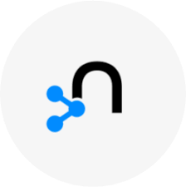

MLOps - Tech Stack
Data
Models
Development
Operations
Spark
Hadoop
Kafka
Dask
Airflow
Pachyderm
Elastic
Neo4j
Weaviate
Data Engineers
Data Scientists
Software Engineers
Systems Engineers
Notes:
Apache Spark: is a unified analytics engine for big data processing, with built-in modules for streaming, SQL, machine learning and graph processing.
Hadoop: is a framework that allows for the distributed processing of large data sets across clusters of computers using simple programming models
NiFi: An easy to use, powerful, and reliable system to process and distribute data.
Kafka: is a distributed event streaming platform for high-performance data pipelines, streaming analytics, data integration, and mission-critical applications
Dask: is a flexible parallel computing library for analytics
Airflow: is a platform started by AirBnB to programmatically author, schedule, and monitor workflows.
Pachyderm: brings together version control for data with the tools to build scalable end-to-end ML/AI pipelines while empowering users to use any language, framework, or tool
Elastic: Elasticsearch is the world’s leading free and open search and analytics solution. With an emphasis on speed, scale, and relevance it's transforming how the world uses data.
Neo4j: is a graph database that combines native graph storage, advanced security, scalable speed-optimized architecture, and ACID
Weaviate: Weaviate is an open source vector search engine that stores both objects and vectors, allowing for combining vector search with structured filtering with the fault-tolerance and scalability of a cloud-native database, all accessible through GraphQL, REST, and various language clients.

Slide 18







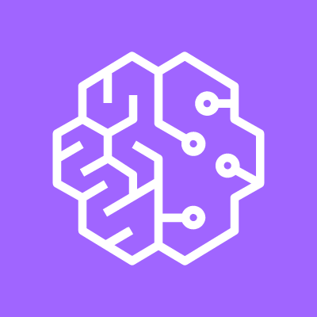
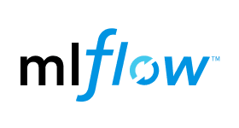



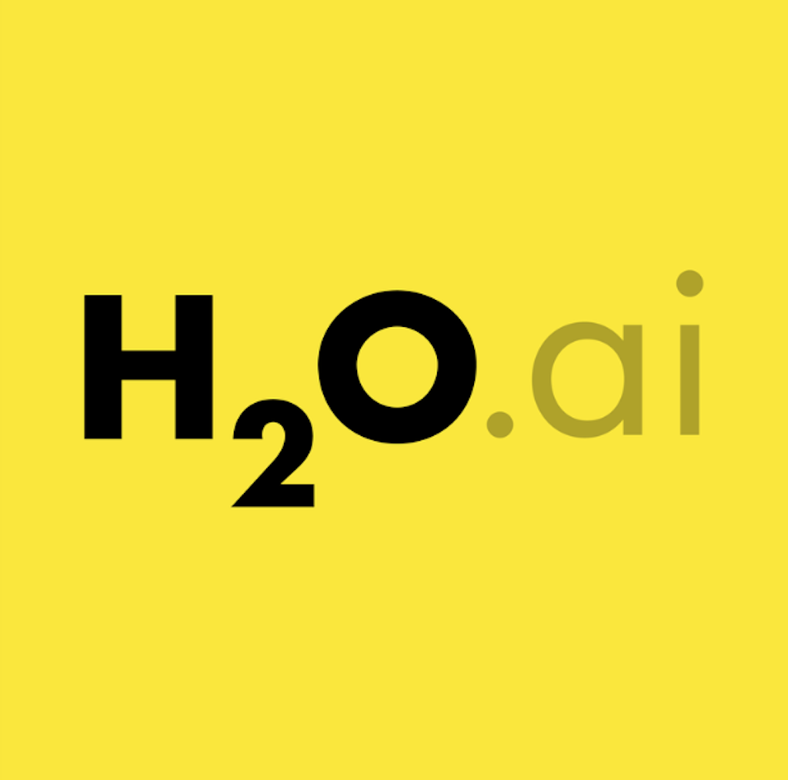

MLOps - Tech Stack
Data
Models
Development
Operations
Spark
TensorFlow
PyTorch
MXNet
Hadoop
Kafka
JupyterLab
Google Colab
Dask
Deepnote
Google AI Platform
Airflow
Amazon Sagemaker
Pachyderm
Weights & Biases
Elastic
Kubeflow
Neptune.ai
Neo4j
H2O.ai
Determined.ai
Weaviate
Data Engineers
Data Scientists
Software Engineers
Systems Engineers
Notes:
TensorFlow: Open source Deep Learning library built by Google
PyTorch: Open source Deep Learning library built by Facebook
MXNet: Open source Deep Learning library built by Apache
JupyterLab: web-based user interface that enables you to work with documents and activities such as Jupyter notebooks, text editors, terminals, and custom components in a flexible, integrated, and extensible manner.
Google Colab: Colab is a Jupyter notebook environment provided by Google that runs entirely in the cloud
Deepnote: is a data science notebook. Jupyter-compatible with real-time collaboration and running in the cloud.
Google AI Platform (Vertex AI): A unified UI for the entire ML workflow. Vertex AI brings together the Google Cloud services for building ML under one, unified UI and API.
Amazon Sagemaker: is a fully managed service that provides every developer and data scientist with the ability to build, train, and deploy machine learning models.
MLFlow: is a platform to streamline machine learning development, including tracking experiments, packaging code into reproducible runs, and sharing and deploying models.
Weights & biases: helps deep learning research projects into deployed software by helping teams track their models, visualize model performance and easily automate training and improving models.
Kubeflow: helps deployments of machine learning (ML) workflows on Kubernetes simple, portable and scalable.
Neptune.ai: is a metadata store for MLOps, built for research and production teams that run a lot of experiments.
H2O.ai: is an end-to-end platform that enables organizations to rapidly build world-class artificial intelligence models and applications.
Determined.ai: deep learning training platform that enables data scientists to train better models, with built-in hyperparameter tuning and distributed training without changing code

Slide 19









MLOps - Tech Stack
Data
Models
Development
Operations
Spark
FastAPI
GitHub
TensorFlow
PyTorch
MXNet
Hadoop
React
Docker
Kafka
JupyterLab
Google Colab
Deepnote
Google AI Platform
Angular
Xcode
Dask
Airflow
Amazon Sagemaker
Android Studio
VS Code
Pachyderm
Weights & Biases
Jet Brains
Elastic
Kubeflow
Neptune.ai
Neo4j
H2O.ai
Determined.ai
Weaviate
Data Engineers
Data Scientists
Software Engineers
Systems Engineers
Notes:
GitHub: is a hosted version control system and helps teams collaborate development
Docker: is a platform for developing, shipping, and running applications in a containerized fashion. Docker enables you to separate your applications from your infrastructure so you can deliver software quickly.
FastAPI: is a modern, fast (high-performance), web framework for building APIs with Python 3.6+ based on standard Python type hints.
React: front-end JavaScript library for building user interfaces or UI components. It is maintained by Facebook
Angular: front-end JavaScript library for building user interfaces or UI components. It is maintained by Google
XCode: Apple's integrated development environment for macOS, used to develop software for macOS, iOS, iPadOS, watchOS, and tvOS
Android Studio: is the official integrated development environment for Google's Android operating system
VS Code: Visual Studio Code is a code editor built by Microsoft, redefined and optimized for building and debugging modern web and cloud applications
Jet Brains: software vendor specializing in the creation of intelligent development tools, including IntelliJ IDEA, PyCharm, WebStorm

Slide 20






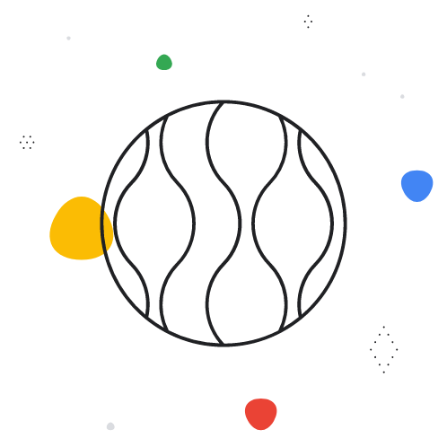

MLOps - Tech Stack
Data
Models
Development
Operations
Spark
FastAPI
GitHub
GCP
AWS
TensorFlow
PyTorch
MXNet
Hadoop
React
Docker
Kubernetes
Kafka
JupyterLab
Google Colab
Deepnote
Google AI Platform
Angular
Xcode
Jenkins
Ansible
Dask
Airflow
Amazon Sagemaker
Android Studio
GitHub Actions
VS Code
Cloud Functions
Pachyderm
Weights & Biases
Jet Brains
TensorFlow Serving
Elastic
Kubeflow
Neptune.ai
Amazon Sagemaker
Hosting
Neo4j
H2O.ai
Determined.ai
Weaviate
DataRobot
Data Engineers
Data Scientists
Software Engineers
Systems Engineers
Notes:
Google Cloud Platform (GCP): Is a suite of cloud computing services offered by Google
Amazon Web Services (AWS): offers reliable, scalable, and inexpensive cloud computing services
Kubernetes: is an open-source system for automating deployment, scaling, and management of containerized applications.
Jenkins: is an automation server which enables developers around the world to reliably build, test, and deploy their software
Ansible: is an IT automation platform that makes your applications and systems easier to deploy and maintain. Automate everything from code to infrastructure.
TensorFlow Serving: is a flexible, high-performance serving system for machine learning models, designed for production environments
Amazon Sagemaker Hosting: is a model hosting environment available through Amazon Sagemaker
DataRobot: is an AI platform that can accelerate and democratize data science by automating the end-to-end journey from data to value. Allows to deploy AI applications at scale

Slide 21
MLOps - Tech Stack
Deep Learning
Development
Operations
Framework:
APIs:
Source Control:
TensorFlow
FastAPI
TF Model Serving
GitHub
Containerization:
Training:
Docker
Google Colab
Kubeflow
Frontend:
HTML
React
Cloud Provider:
Google Cloud Platform
Tracking:
IDE:
Continuous Integration/ Deployment:
W&B
Custom
VS Code
IDE of choice
GitHub Actions, Ansible
Scaling:
Kubernetes
Notes:
In this class we will be using the following tech stack and the tutorials and examples will cover these topics

Slide 22
Outline
Why should you take this class and why not?
Who are we?
Course structure and activities?
Class organization (Workload, Logistics, Grades).
Projects

Slide 23
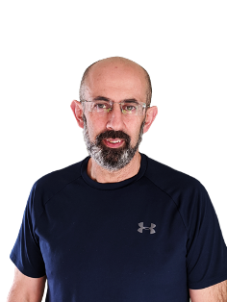
Who? The Astro-Statistician Who Rocks The Kitchen!
Roles:
The Science Wizard: Scientific Director of IACS.
Course Maestro: Instructs CS109a, CS109b, and AC215 like a boss.
Astro-Guru: Stoked about the next-gen telescopes that are about to revolutionize our view of the universe!
Research Lab:
StellarDNN Maverick: Tackles cosmic mysteries where astronomy, ML, and stats collide!
His Interests? Cracking open differential equations with deep neural networks, being a detective in deep neural network inference, and teaching NLP techniques to chat with stars (well, in astronomical time series analysis, but let's keep it jazzy!).

Slide 24

Who? The Astro-Statistician Who Rocks The Kitchen!
Fun Facts:
Musical Soul: Classical tunes and opera are his jam. The Boston Symphony Orchestra is his second home!
Culinary Artist: Holds a cooking badge of honor from Le Cordon Bleu and enjoys both whipping up a storm and devouring the results.
Adventure Junkie: From biking up mountains to skiing down them, from kayaking to hooking fish mid-air—this professor is always on the go!

Slide 25



Who ?
Rashmi Banthia
TF for many Data Science classes here at Harvard including CS109A/B.
Fun Fact: Enjoys kaggle competitions
Andrew Smith
Passionate about using machines to model and assist the human creative process
Fun Fact: Has produced concerts on five different continents
Connor Capitolo
Machine Learning Engineer
Graduated from Master’s in DS program in May 2022
Fun Fact: Loves to go fly fishing

Slide 26



Who ?
Shivas Jayaram
Deep Learning Researcher, Educator and Practitioner
Working on medical-pharma knowledge platform startup
Fun Fact: He is a dog lover
Tale Lokvenec
Tale is a Founding Machine Learning Engineer at Zenlytic, specializing in natural language processing (NLP) and ML system design.
Fun Fact: He is a super basketball player and until the age of 16 he was in the national team of Macedonia.
Matthew Nazari
Deep Learning Researcher and Student. Developing online language learning spaces for the Northeastern Neo-Aramaic dialects
Fun Fact: You can concatenate ChatGPT onto a morphological parser to perform zero-shot translation on Neo-Aramaic

Slide 27
Outline
Why should you take this class and why not?
Who are we?
Course structure and activities?
Class organization (Workload, Logistics, Grades).
Projects

Slide 28
Course Structure and Activities
Two lectures/tutorials per week.
Projects

Slide 29
Lectures
Two lectures per week - What to expect
Lecture & Tutorials
Pre-session
Assignment
(Reading)
There will be one reading suggestion per week

Slide 30
Topics
Containers
Data Pipelines, Dask & Cloud Storage
Data Parallelization
Data Versioning
Advanced Training Workflows
Advanced Inference Workflows
Pipeline
App Design, Setup, and Code
APIs & Frontend
Scaling (k8)

Slide 31
Team Projects: Crafting Your Own AI Solutions
Objective: Hands-on project development in AI & MLOps; transform your idea into a functional app.
Guidance: Weekly demonstrations from Pavlos' project provide practical insights and a reference point.
Milestones: Assess project evolution and grasp of MLOps concepts; crucial for grading.
Creativity: Open platform for start-up ideas, research, or personal hobbies.
Assessment: Milestones are key to grades and holistic development.
Group Formation: Starts today, aiming for teams of 4-5.

Slide 32
Projects Milestones
Milestone | Description | Due Date | Points
MS1 | Project Proposals & Team Formation | 09/14 | 5
MS2 | MLOps & Advanced Training | 09/26 | 10
MS3 | Scalable Computing | 10/05 | 15
MS4 | Midterm Presentation | 10/24 | 25
MS5 | Full-Stack Development | 11/14 | 10
MS6 | Final Presentation and Deliverables | 12/12 | 35

Slide 33
Outline
Why should you take this class and why not?
Who are we?
Course structure and activities?
Class organization (Workload, Logistics, Grades).
Projects

Slide 34
Workload
1 hour Reading
2.5 hours Lectures
1 hour Office Hour/meet with your TF
7 hours Project Milestones
~ 12 hours/ week

Slide 35
Expectations: Attendance
Attendance in class is not merely a requirement; it is a criterion I heavily weigh when considering academic and professional endorsements. Please understand that consistent presence and engagement in the classroom are highly valued in this course.

Slide 36
Expectations: Projects
This course is project-based, and your entire grade will depend on the quality of your project. We will place significant emphasis on both the effort you put into the project and the quality of your completion of its milestones.
While project-based courses generally make it easier to achieve a high grade, we will thoroughly assess each component and provide comprehensive feedback. We expect you to incorporate this feedback into your work for subsequent milestones.

Slide 37
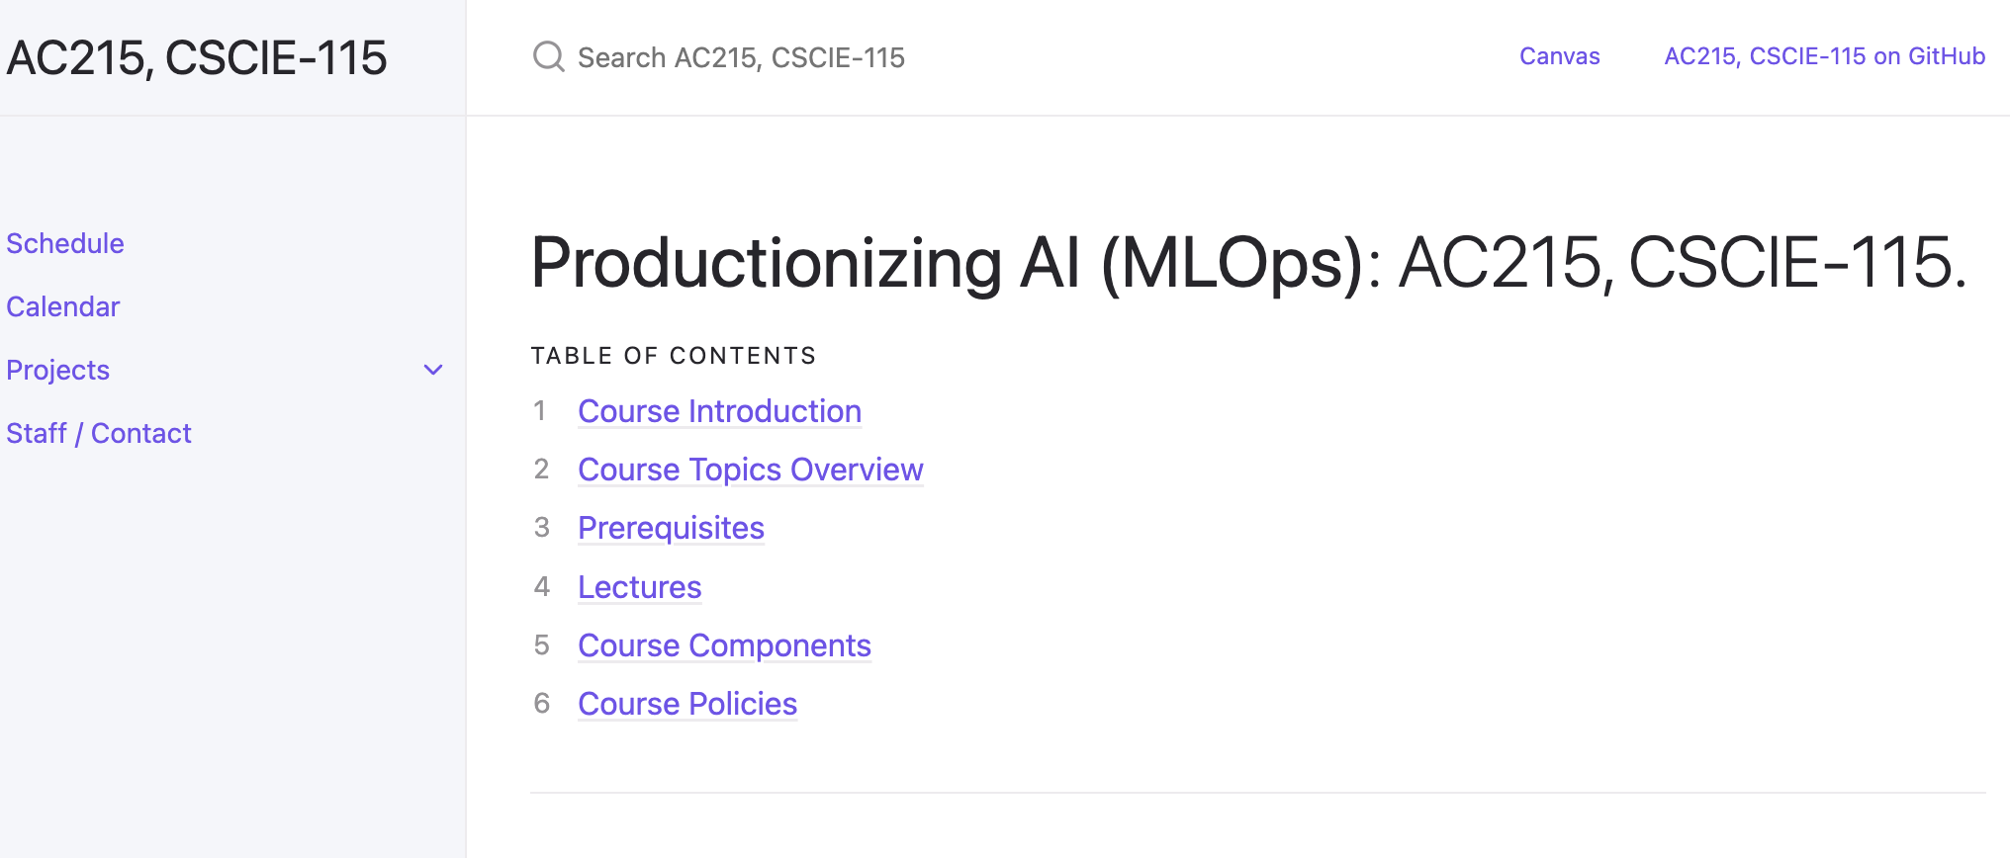
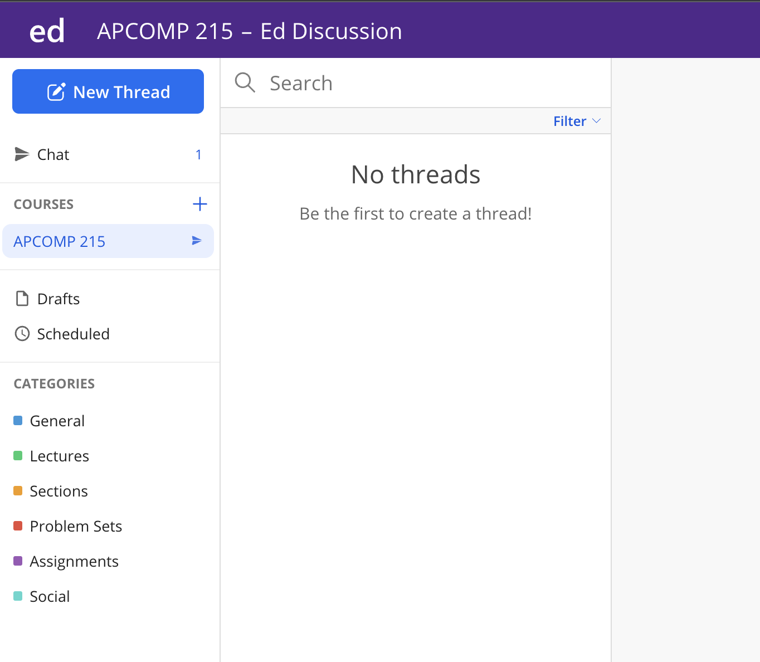
Course Components
Course web page
ED Stem
https://harvard-iacs.github.io/2023-AC215/
https://edstem.org/us/courses/42775/discussion/
Notes:
https://harvard-iacs.github.io/2023-AC215/
https://edstem.org/us/courses/42775/discussion/

Slide 38
Grades
Assignment | Final Grade Weight
Milestone 1 | 5%
Milestone 2 | 10%
Milestone 3 | 15%
Milestone 4 | 25%
Milestone 5 | 10%
Milestone 6 | 35%
Total | 100%

Slide 39
Final Details
We will be using ED for discussions, announcements and surveys
Projects: Group
Submissions for project milestones and projects will be using GitHub – details will follow soon

Slide 40
Logistics
Survey
Make project groups

Slide 41
Outline
Why should you take this class and why not?
Who are we?
Course structure and activities?
Class organization (Workload, Logistics, Grades).
Projects

Slide 42
Projects
In Class Demo Mushroom Identification App

Slide 43
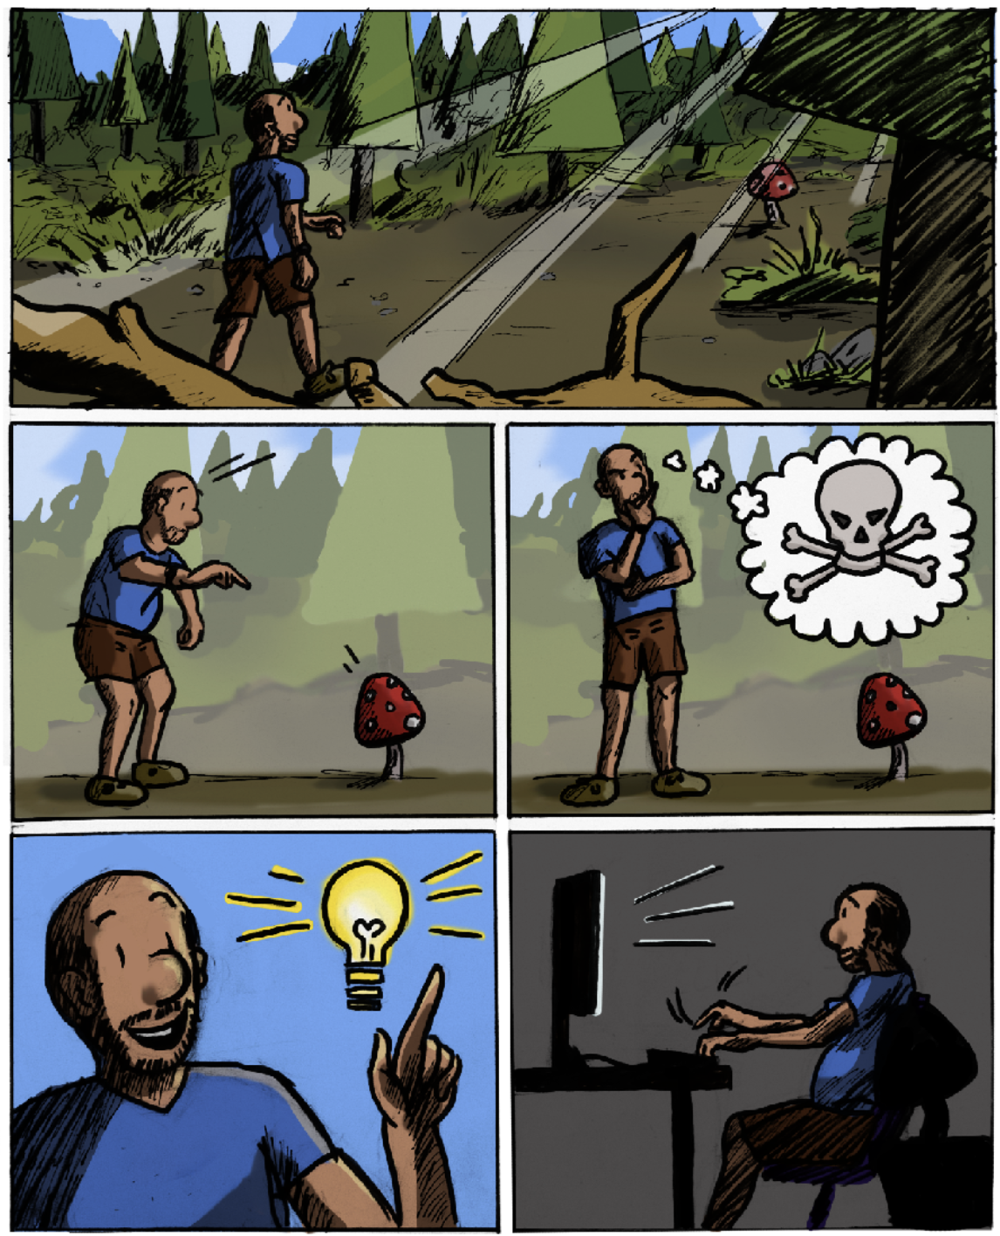
Project Idea
Pavlos likes to go the forest for mushroom picking
Some mushrooms can be poisonous
Help build an app to identify mushroom type and if poisonous or not
Project Summary
Credit: Nikolas Protopapas

Slide 44
Problem Definition
Pavlos like to go to the forest to do mushroom picking. It is a fun activity and also rewarding as some mushrooms are edible. The problem is in the forest where Pavlos goes to pick mushrooms there are many varieties of poisonous mushrooms. Some of the mushrooms are obvious but there are some which he requires help in identification.

Slide 45
Proposed Solution
Pavlos will have is phone with him when he is in the forest. What if he could just take a picture of the mushrooms and and app could tell him what type of mushroom it is and weather it is poisonous or not

Slide 46
Project Execution Steps
Project Ideation / Requirements
Data Exploration
Model Exploration
Prototyping
Model Serving
Product Development
ML Integration
Deployment

Slide 47
How to Scope your Project
Proof Of Concept (POC)
Prototype
Pilot
Minimum Viable Product (MVP)
Experiment potential ideas
Check feasibility of the idea
Use a subset of data to make experiments simpler to run
E.g.: Verify if our language task can be performed by transfer learning using a transformer model
Users: Internal team
Duration: Days to few weeks
A mockup or functional product that can showcase your ideas
E.g.: A mockup web app to show user experience and flow
Users: Internal team
Duration: Weeks
A usable and functional product of your solution
Used to test out the product with real users and performing real use cases
E.g,: An api endpoint of a model for prediction, a simple one page app to showcase a model’s prediction capability
Users: Internal / External
Duration: Weeks
Expanding on the Pilot to build something that real users can use
E.g.: Production deployed app that can predict if a mushroom is poisonous or not
Users: External
Duration: Months

Slide 48
Project Scope (Mushroom App)
Proof Of Concept (POC)
Prototype
Minimum Viable Product (MVP)
Scrap mushroom data
Verify images
Experiment on some baseline models
Verify new unseen mushrooms are predicted by the model(s)
Visualize model activations to analyse what the model is seeing
Create a mockup of screens to see how the app could look like
Deploy one model to Fast API to service model predictions as an API
Create App to identify Mushrooms
API Server for uploading images and predicting using best model

Slide 49
THANK YOU
Notes:
PP: Add a slide to point to the tutorials

